Slide 1
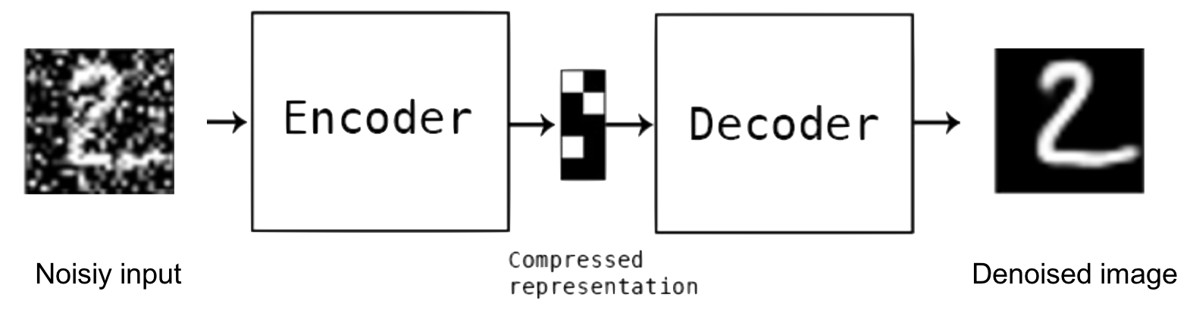
Which images are likely in 𝒮?

Slide 2
d
k
d
d
x^{T}
=
f(x)^{T}
W₂
W₁
decoder
encoder

Slide 3
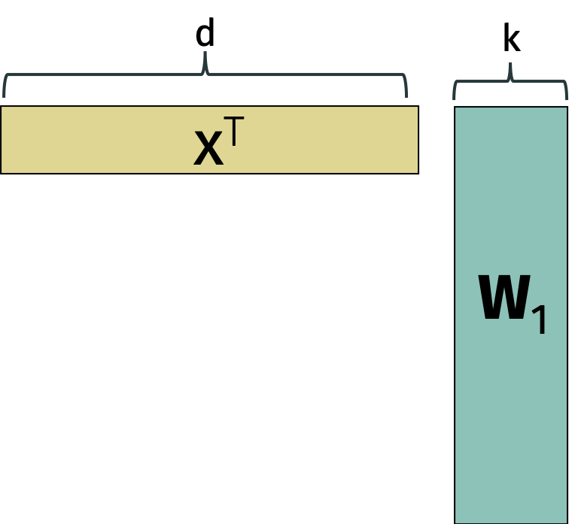
encoder
d
z
=
f(x)^{T}
W₂
k
decoder

Slide 4
d
k
d
d
x₁
~
W₂
x₁
~
x₂
x₂
W₁
=
~
X
X
x_{n}
~
x_{n}

Slide 5
k
d
d
z₁
W₂
z₂
=
~
Z= XV_{k}
X
z_{n}

Slide 6
k
d
d
z₁
V_{k}^{T}
z₂
k principal components
=
~
Z= XV_{k}
X
z_{n}
n loading
vectors

Slide 7
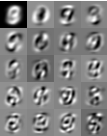
k principal components
k
d
d
z₁
V_{k}^{T}
z₂
v₁
v₃
v₂
=
~
Z= XV_{k}
X
z_{n}
n loading
vectors

Slide 8
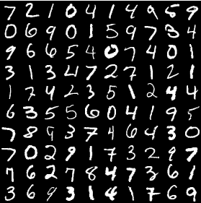
k
d
v₁
x
≈
z
...
v_{k}
k principal components
Z= XV_{k}
n loading
vectors
⟨
⟨
⟩
⟨
⟩
...
,
⟩
z₂ =
,
z₃ =
,
z₁ =
x
v₁
x
v₂
x
v₃

Slide 9
k
d
≈
v₁
x
z
...
v_{k}
≈
+ z₂∙
+ z₃∙
+ z₄∙
+ ...
z₁∙
x
v₁
v₂
v₃
v₄

Slide 10
d
k
d
x₁
c₁
V^{T}
x₂
c₂
X
=
C
+
R
x_{n}
c_{n}

Slide 11
=
1
0
U^{T}
U
1
1
0
1
1

Slide 12


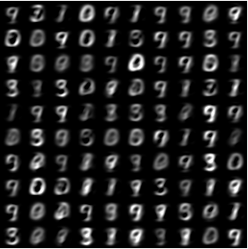
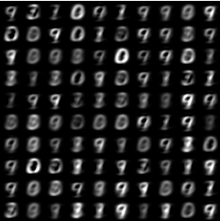
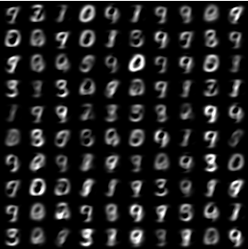
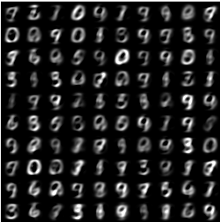
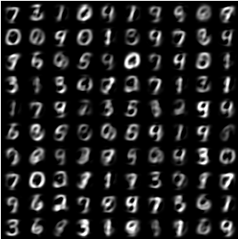
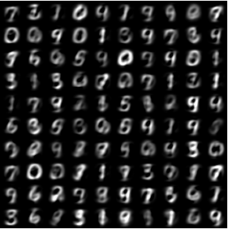
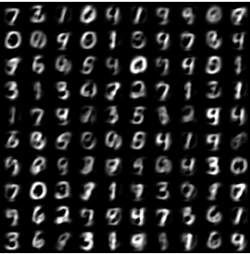
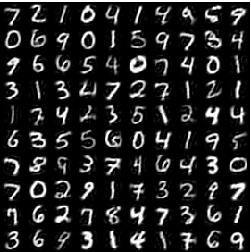
original data
rank 1 approx.
rank 2 approx.
rank 3 approx.
rank 4 approx.
rank 5 approx.
rank 6 approx.
rank 7 approx.
rank 8 approx.
rank 9 approx.
rank 50 approx.

Slide 13
x₂
v₁
x
~
x₂
x₁
v₂
v₁
z₁∙v₁
~
~
x₁
x₃
x₃

Slide 14
v₁
v₁
z₂
x₂
v₂
v₂
0
0
x₁
x₃
z₃
z₁

Slide 15
excellent
easy
great
diffucult

Slide 16
rank 1 approx.
rank 2 approx.
rank 3 approx.
original data
rank 6 approx.
rank 4 approx.
rank 5 approx.
rank 7 approx.
rank 9 approx.
rank 50 approx.

Slide 19
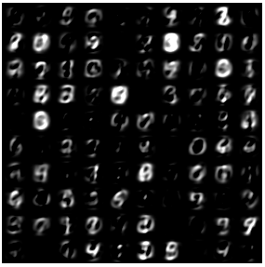
denoising
synthetic data generation
single nucleotide polymorphisms (SNPs) loci
144 312 436 800 943
individual 1
individual 2
...
individual n
A T T C G
T G G C C
C A T A G

Slide 20
~
x
z
x
1 2 2 4 3 1
.54 .21
encode
decode
single nucleotide polymorphisms (SNPs) loci
144 312 436 800 943
individual 1
individual 2
...
individual n
A T T C G
T G G C C
C A T A G

Slide 21
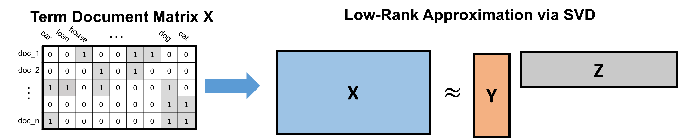
single docuement
term-document matrix
BOW features
LSA features
PCA
Y
x
≈
z
word vectors
document vectors
Y
M
≈
Y^{T}

Slide 22
≈
Y
z
z
word vectors
x
document vectors
term-document matrix
remove
“stop words”
Very small and handy for traveling or camping.
[ small, handy, traveling, camping ]

Slide 23
word
embedding
[ small, handy, traveling, camping ]
y₁ y₂ ... y_{q}
???
y₁ y₂ ... y_{q}
x
y₁ y₂ ... y_{q}
feature vector
SVD
y₁ y₂ ... y_{q}
v₁ v₂ v_{k}
x

Slide 24
small
average
handy
useless
average
heavy

Slide 25
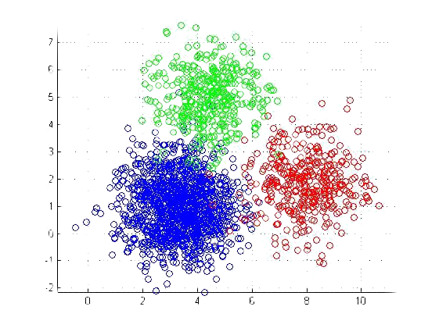
clustering

Slide 26
